Slide 1
World Economic Indicator Project BY Gaurav kumar

Slide 2
BUSINESS PROBLEM
Analysis on how a country can attain sustainable GDP growth using various factorS.
SOLUTION
we perform analysis on the data provided and using different methods we try to find the features which can lead to sustainable growth of a country
DATA USE
1. GDP
2. Health Exp/capita
3. energy usage
4. birth rate
5. population total
6. population urban
7. tourism inbound
8. internet usage
9. mobile phone usage

Slide 3
EXECUTIVE SUMMARY
➢Tourism contributes a lot to a country’s GDP and it is important that a country invests in a sustainable tourism by getting sustainable business practices , adopting more sustainable methods of transportation, staying in more environmentally friendly accommodation, eating locally and ethically sourced foods .
➢Rapid urbanisation only leads to traffic congestion , overcrowding , environmental degradation and air pollution . It can also put added pressure on food supply systems. It is important for a country to get policies to make sure the urban land expands more so ease the congestion so there is less stress on environment for a sustainable growth.
➢The Internet and mobile phones helps to bring sustainability to the entire population, with up-to-date information and day-to-day solutions, through which the internet user can make their life more sustainable. Also data collected using internet can give us useful information for environmental monitoring
➢We see there is a strong correlation between energy usage and GDP, which means with increase in energy usage ,GDP increases. But energy usage also increases CO2 emission so it is recommended to consume more renewable energy for a sustainable growth in GDP.
➢Sustainable growth largely depends on a healthy population . When a country invest more on public health infrastructure and its development it increases overall health of the population which increases a sustainable growth .
➢More population does not always result in growth in GDP. Overpopulation can adversely affect sustainability due to overexploitation of resources. Its important to keep the population in check.

Slide 4
DETAILED ANALYSIS
UNIVARIATE ANALYSIS
1. GDP
2. Health Exp/capita
3. Energy usage
4. Birth rate
5. Population total
6. Population urban
7. Tourism inbound
8. Internet usage
9. Mobile phone usage
BIVARIATE ANALYSIS
1. GDP vs Health Exp/capita
2. GDP vs Energy Usage
3. GDP vs Birth Rate
4. GDP vs Population total
5. GDP vs Population Urban
6. GDP vs Tourism Inbound 7
. GDP vs Internet Usage
8. GDP vs Mobile phone Usage

Slide 5
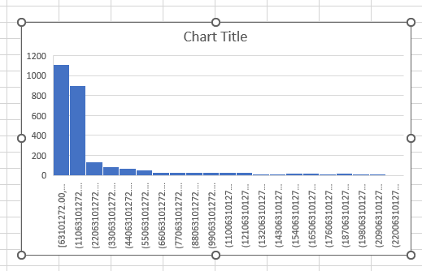
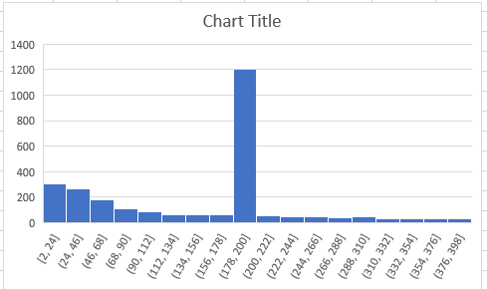
GDP HEALTH/CAPITA
Health Exp/capita : mean and trimmean are different ,so there are outliers in the data .From the histogram we can say that the distribution is right skewed , there is one single bar which is bigger compared to other bars which are very small .
GDP : mean and trimmean are different ,so there are outliers in the data ,also from the histogram we can say that the distribution is right skewed , there is one single bar which is bigger compared to other bars which are very small .

Slide 6
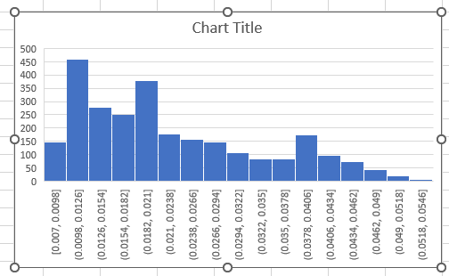
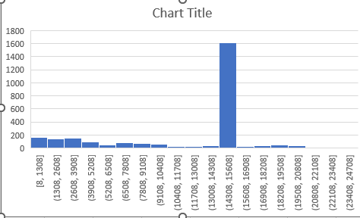
Energy usage : mean and trimmean are different ,so there are outliers in the data .from the histogram we can say that the distribution is right skewed , there is one single peak which is bigger compared to other bars which are very small .90% of the data seems to be concentrated at that bar .
Birth rate : mean and trimmean are almost equal ,so there are no outliers.the distribution is skewed to the right but with two high peaks .
Birth rate
mean | 0.022642
median | 0.02
stdev | 0.011106
trimmean | 0.022066
Energy usage
mean | 4494.941
meadian | 14338
stdev | 5361.982
trimmean | 11564.58

Slide 7
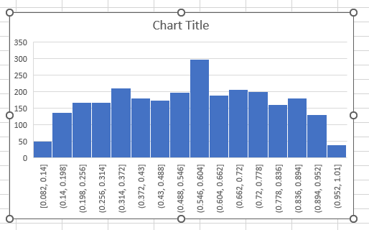
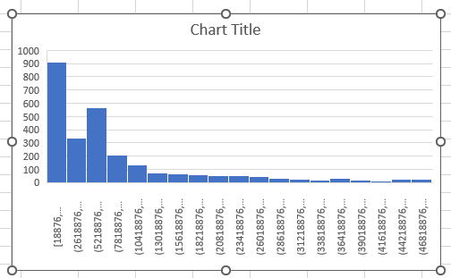
Population total : mean and trimmean are different ,so there are outliers in the data .from the histogram we can say that the distribution is right skewed , there is one single peak which is bigger compared to other bars which are very small .90% of the data seems to be concentrated at that bar .
Population urban :mean and trimmean are almost equal ,so there are no outliers.The distribution is almost normal (bell shaped).
Population total
Population urban
mean | 8539279
median | 5904170
stdev | 10503413
trimmean | 7202340
mean | 0.546318
median | 0.562
stdev | 0.229682
trimmean | 0.546573

Slide 8
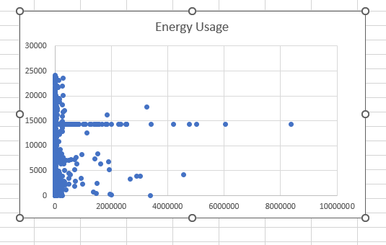
BIVARIATE ANALYSIS
GDP/capita and Energy Usage Scatterplot shows a linear trend , the points are not scattered much ,there is a linear correlation between the two variables. correlation between energy usage and GDP is 0.00832 which is negative and has low magnitude , so we can say that as the energy usage of a country increases the GDP also grows along with it .But with increase in energy usage , CO2 emission is increased which affects sustainable growth of a country .So measures aimed at limiting the production of energy based on fossil fuels should be implemented, continued, and intensified. High economic growth is a necessary factor for improving the living conditions of citizens, but it is not the only one. Hence, it is also beneficial to implement an energysaving policy. Perhaps one solution is to introduce relevant tax solutions or impose penalties for excessive energy consumption. It is recommended to consume more renewable energy .Energy production based on renewable energy sources, including water, wind, and sun, does not adversely affect the natural environment. Solutions promoting its use can contribute to less pollution of the environment, and therefore better living conditions for all of us.

Slide 9
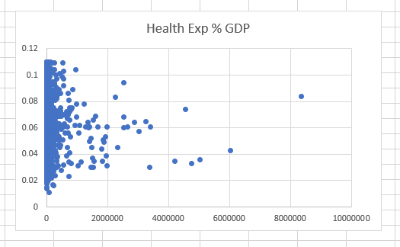
HEALTH EXP/CAPITA and GDP/capita Correlation between health exp and GDP is –0.02764which is a negative and moderate in magnitude. From the scatterplot we can see that there is a linear trend and the points are not so randomly scattered on the chart. Therefore we can say that health exp/capita increases , there is a growth in GDP. Also sustainable growth largely depends on a healthy population. When a country invest more on public health infrastructure and its development it increases overall health of the population which increases a sustainable growth .

Slide 10
THANK YOU

